Slide 1
Freemium to Premium
- An Innovative Offer Strategy to Drive Growth
India has millions of free users; very few convert to Premium.
Highlight benefits of Premium: ad-free, offline, high-quality audio.
Bar chart showing % of free vs. premium users in India.

Slide 2

Audience Segmentation Who Are We Targeting? Personas: Student Sneha (20): Loves K-pop, budget-conscious, always on Instagram. Regional Ramesh (27): Listens to Telugu/Hindi music, new to streaming. Busy Bhavya (30): Gym-goer, listens during commute, dislikes ads. Indie Ishan (24): Fan of independent artists, seeks ad-free sessions to support creators. Podcast Priya (29): Podcast listener, uses Spotify daily while cooking or walking. Family Farhan (35): Family of 4, uses one account for everyone, concerned about cost.

Slide 3







Offer Concepts
Offer Name | Description | Target Persona | Price/Type
Mini Festival Pass | ₹9 for 7 days of Premium during festivals | Regional Ramesh | ₹9
Weekend Premium Trial | Free Premium access every Fri–Sun | Student Sneha | Free trial
Playlist Power-Up | Complete 5 curated playlists to unlock 7-days of Premium | Busy Bhavya | Free (gamified)
Indie Boost Offer | Discounted Premium for those who follow 3 indie playlists | Indie Ishan | ₹19
Podcast+ Access | Premium trial unlock with 3 podcast completions | Podcast Priya | Free (content-linked)
Family Starter Pack | First month family plan at ₹49 with family invite bonus | Family Farhan | ₹49

Slide 4

Promotion & Execution Plan
Channels: In-app banners, push notifications, social media, emails
Influencers: Collaborate with local/regional music creators and podcasters
Testing: A/B testing across cities (Tier 1 vs Tier 2 vs Tier 3)
Localization: Festival-specific designs, regional language targeting
Metrics: CTR, activations, trials, churn, paid conversions, playlist completions
How Will We Launch These Offers?

Slide 5

1. Estimated 12–20% trial-to-paid conversion (varies by offer) 2. Boost in daily listening time and app stickiness 3. Higher engagement with curated playlists and podcasts 4. Reduced account sharing through family onboarding 5. Funnel Visualization: Free → Trial → Conversion → Retention
Expected Impact

Slide 6
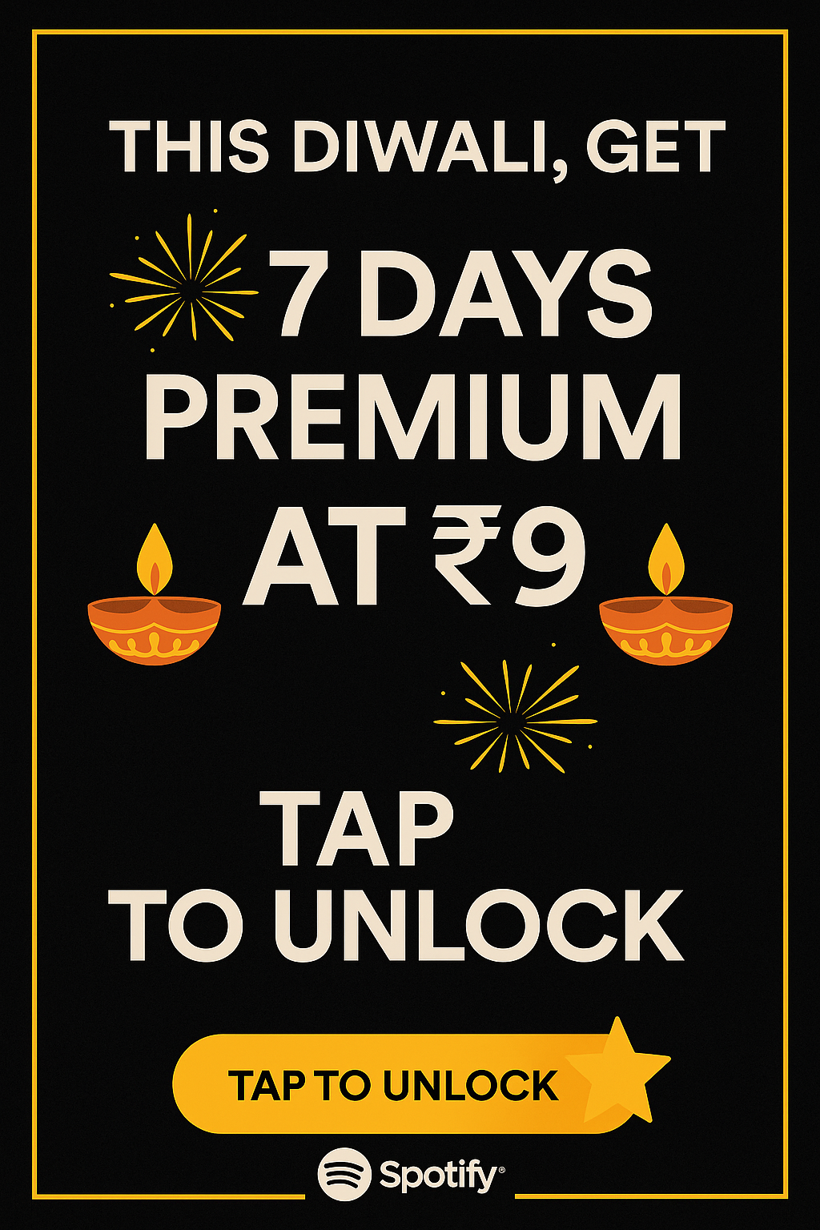
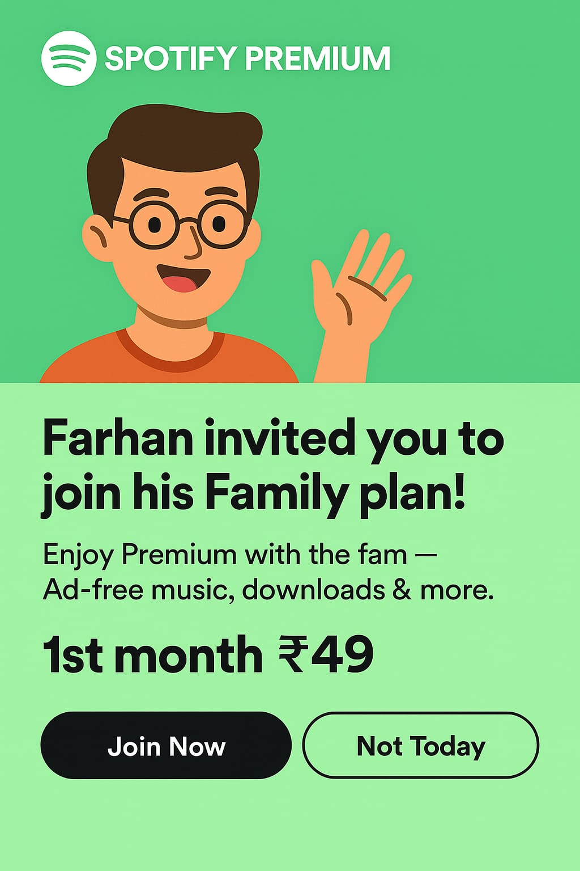
📸Visual Mockups

Slide 7
